Slide 1
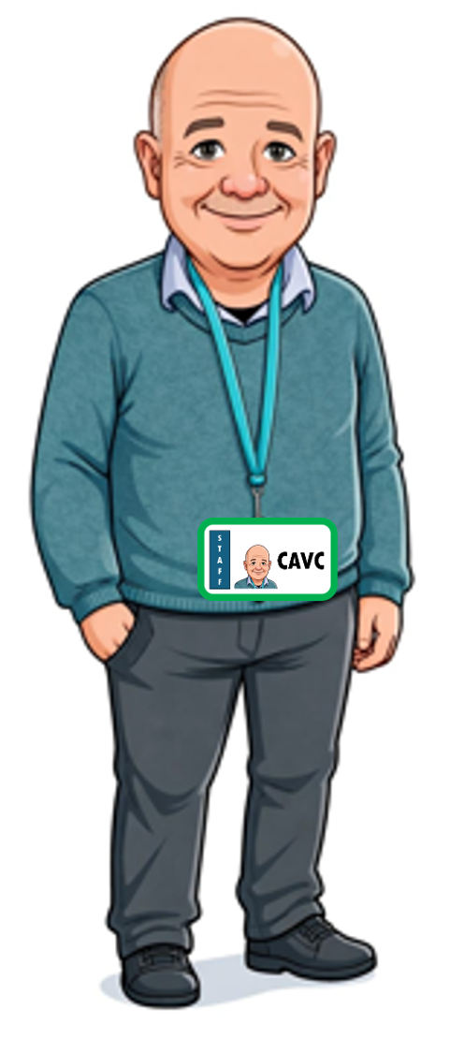
15) ESCCCP24 2025-2026 18 June 2026 Cover

Slide 2
Check-in
Thu 18 June 2026

Slide 3
Using 16_tenses_lesson.pptx and B2_16_tenses_worksheet.docx, we
Learnt the 16 tenses in English plus the imperative, and
Practiced making the passive
Using Plus FCE Opinion Piece.pptx and 06)PlusFCE Discursive Essay_pp74-78.pdf, we
Started p. 78 Ex 3.
Homework
06)PlusFCE Discursive Essay_pp74-78.pdf
p. 78 Ex 3. See next 3 slides.

Slide 7
Integrated Skills
17:45-20:45

Slide 8
Plus FCE Job Application.pptx
12)PlusFCE_JobCoverLetter_pp139-143.pdf

Slide 9
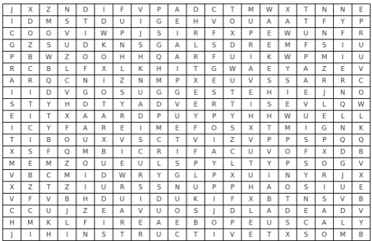

Slide 10
Check-out
Thu 18 June 2026

Slide 11
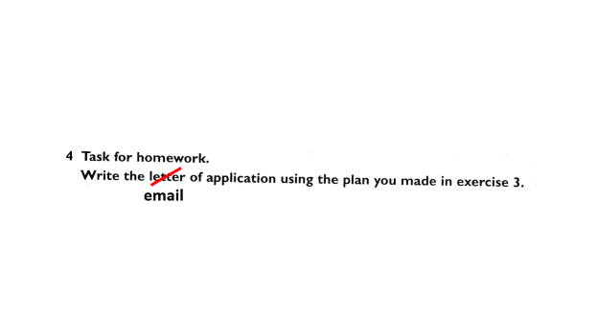
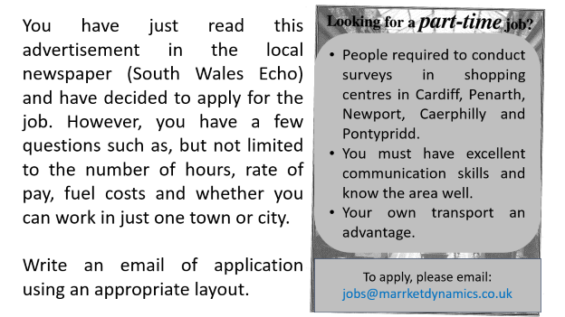
Using Plus FCE Job Application.pptx and 12)PlusFCE_JobCoverLetter_pp139-143.pdf , we
learnt to write cover letters and ask for extra information.
Homework
Plus FCE Job Application.pptx Ex 3 and 4 slides 63 and 64. See below.

Slide 12
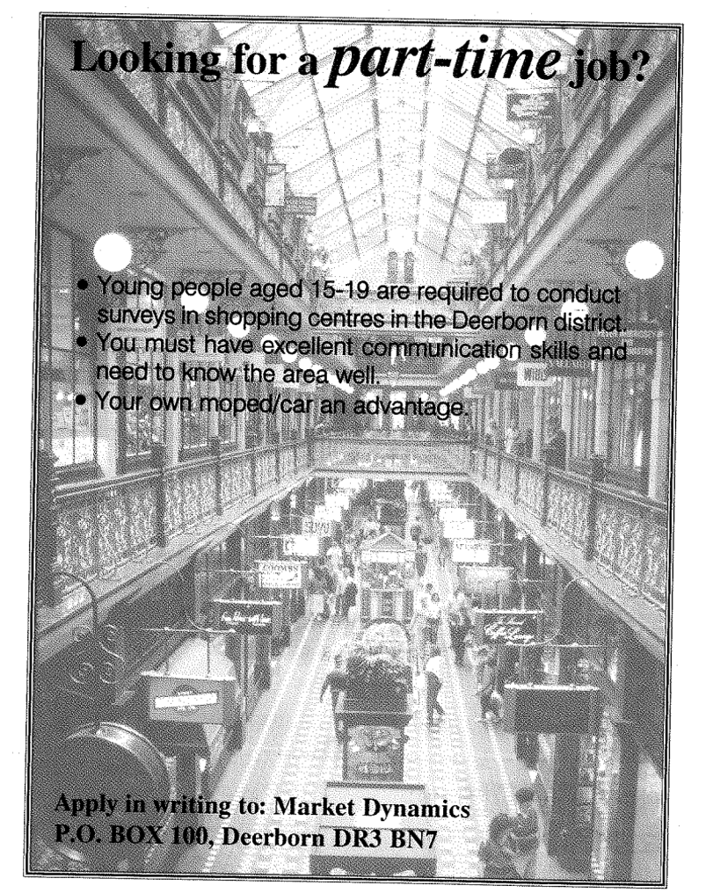
You have just read this advertisement in the local newspaper (South Wales Echo) and have decided to apply for the job. However, you have a few questions such as, but not limited to the number of hours, rate of pay, fuel costs and whether you can work in just one town or city.
Write an email of application using an appropriate layout.
People required to conduct surveys in shopping centres in Cardiff, Penarth, Newport, Caerphilly and Pontypridd.
You must have excellent communication skills and know the area well.
Your own transport an advantage.
To apply, please email: jobs@marrketdynamics.co.uk

Slide 13
email

